Slide 1
CYBER SECURITY CLUB
Introductory Session
Get ready to dive into a world full of endless possibilities!

Slide 2
What should you expect in this session
01
02
03
04
Explore the realm of the cyber world
Meet the Team!
Join our tech team as they help you to explore infinite opportunities
Learn more about the people that make the club what it is
Website Launch
Registrations
Witness the launch of our very own Cyber Security Website!
Ready to join us in our quest? Register and be a part of the club now!

Slide 3
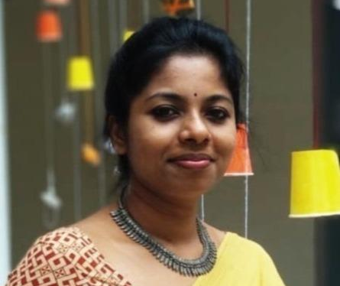
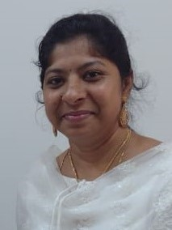
Dr. Panchami V
Dr. Lavanya Settipalli
Head Of Department
CSE - Cyber Security
Faculty-In-Charge, Assistant Professor
CSE - Cyber Security

Slide 4
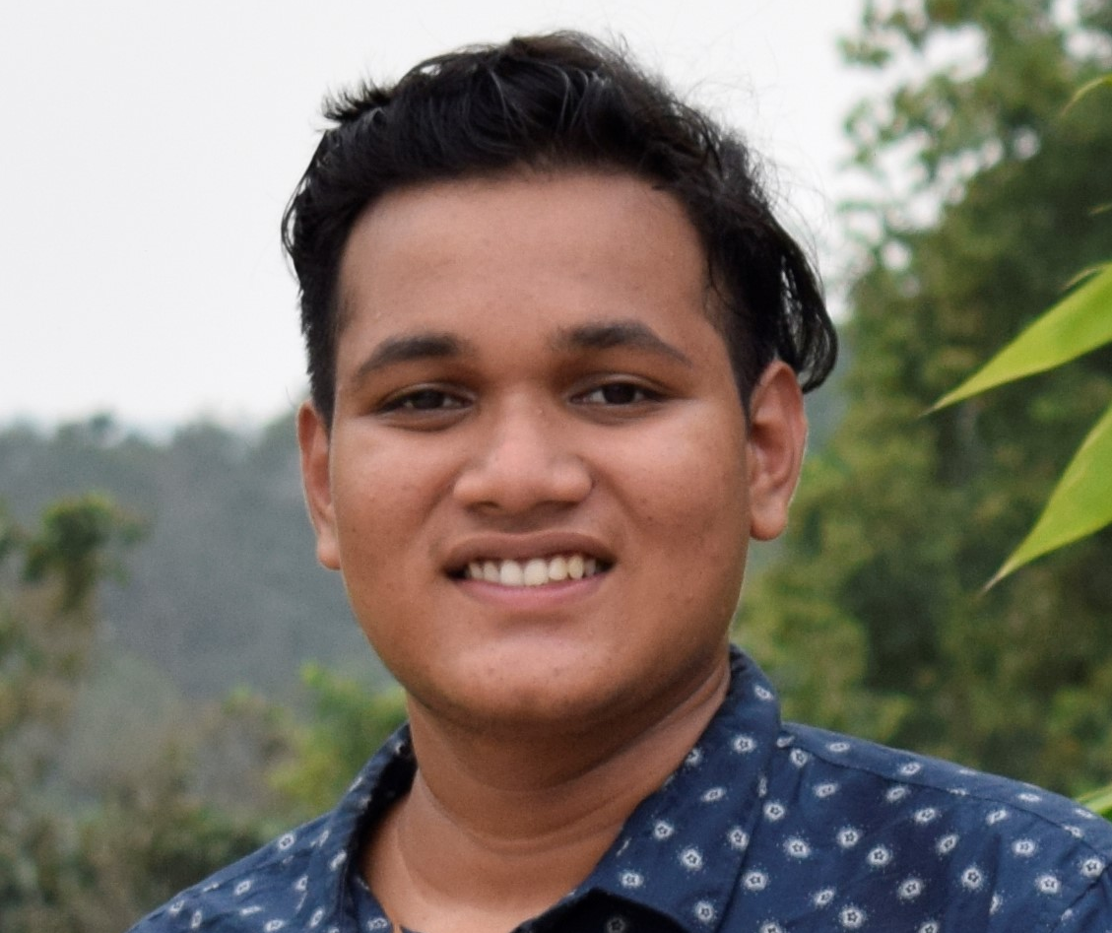
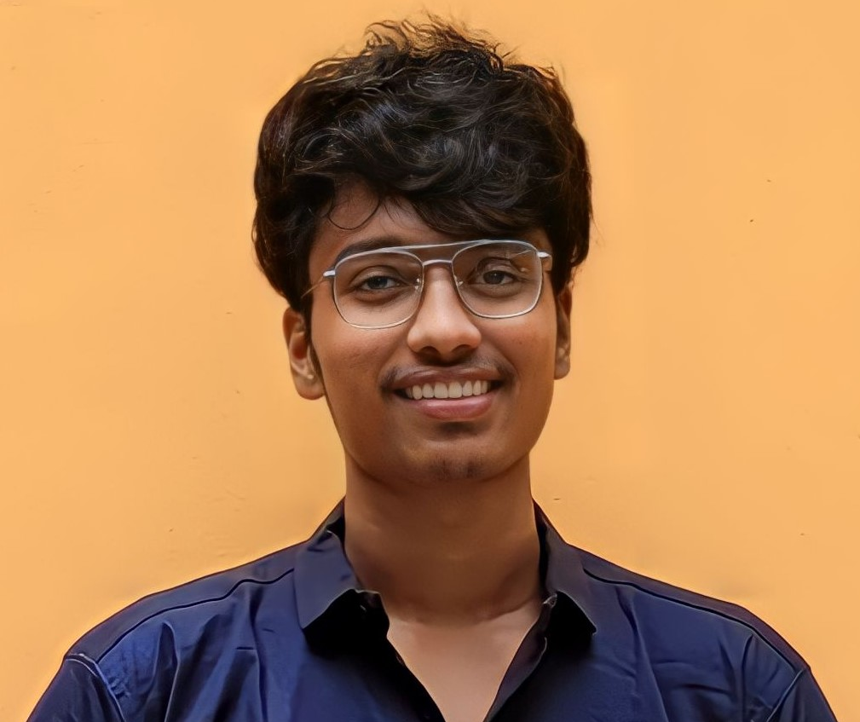
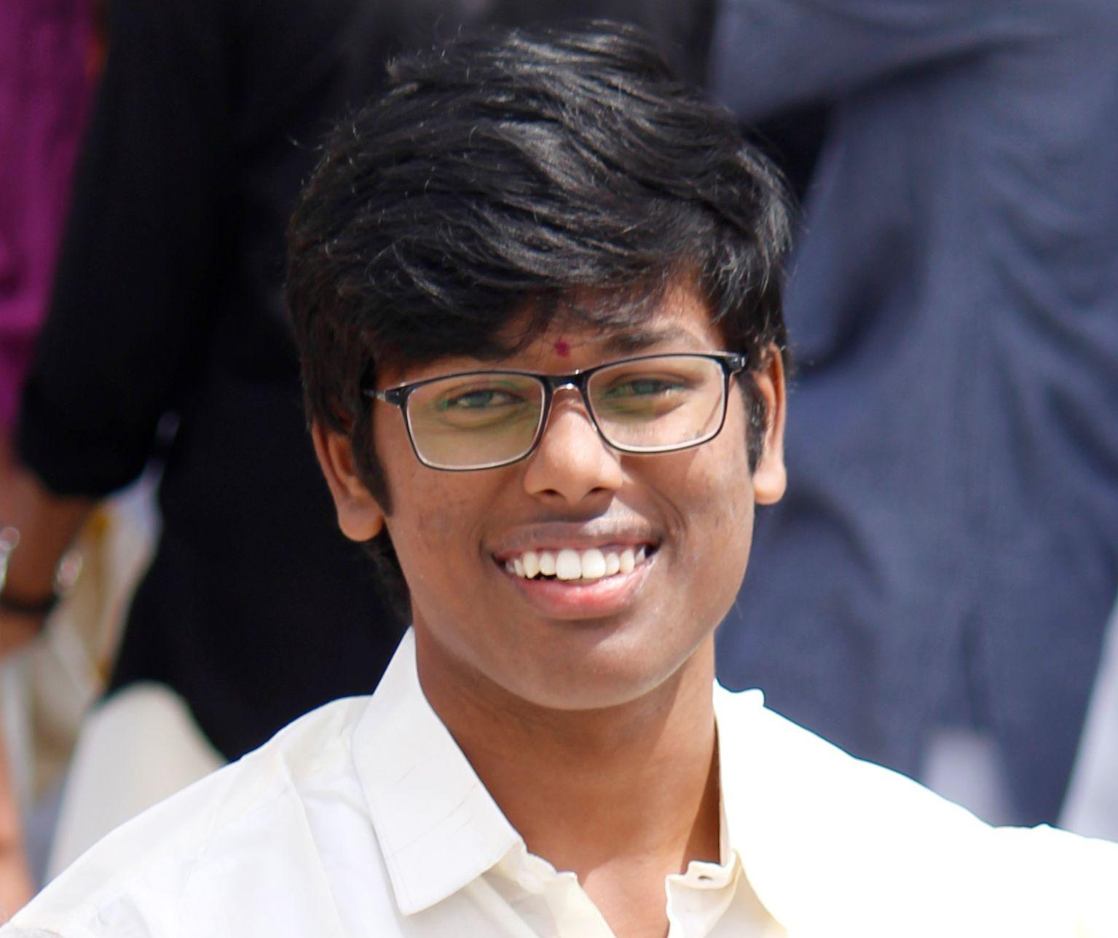
Introducing our Club Leads!
Tanuj Karteek Allena
Ajay Krishna Narayansetti
Darisi Priyatham
Batch 2021
Cyber Security
Batch 2021
Cyber Security
Batch 2021
Cyber Security

Slide 5
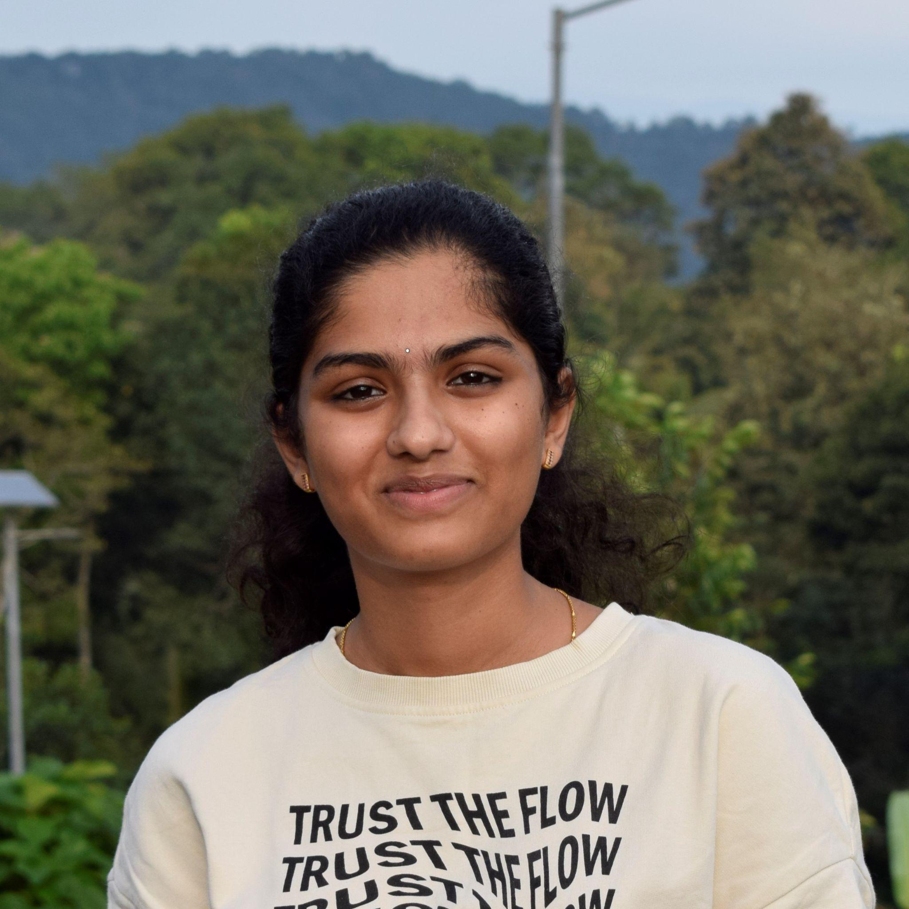
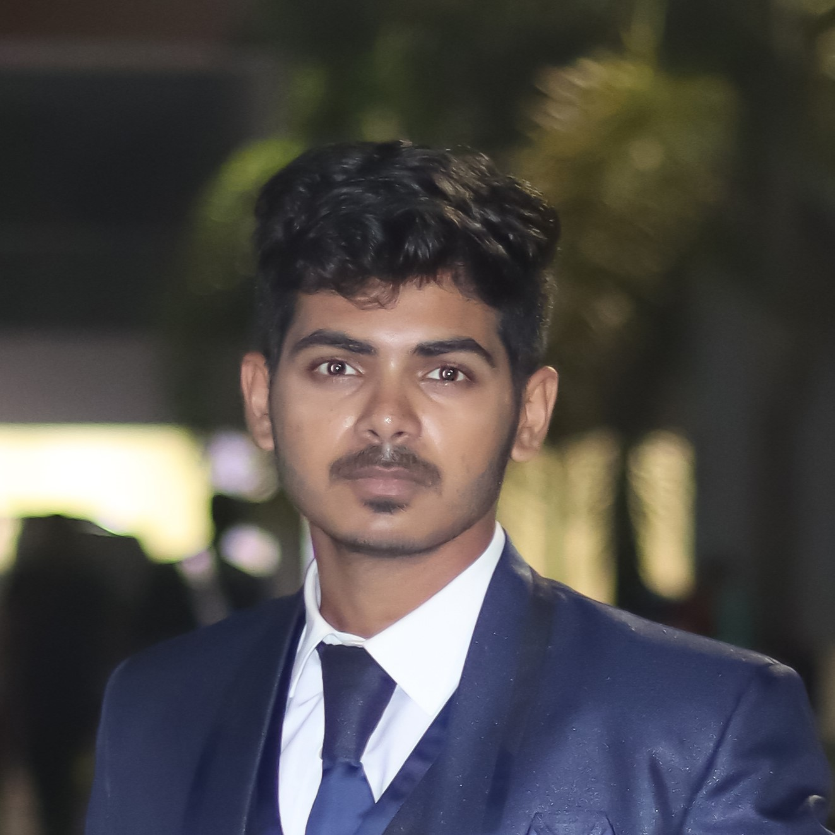
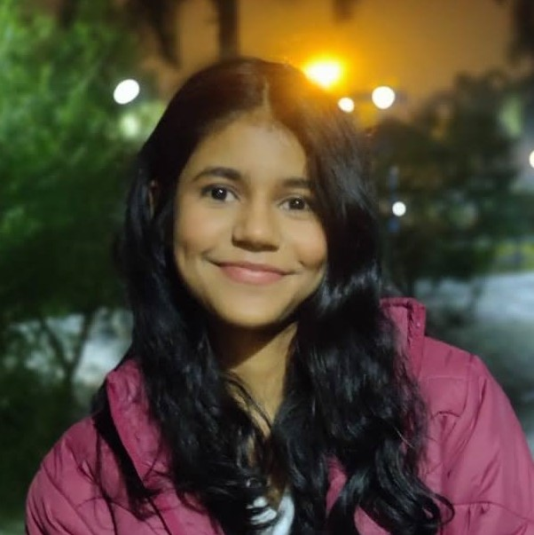
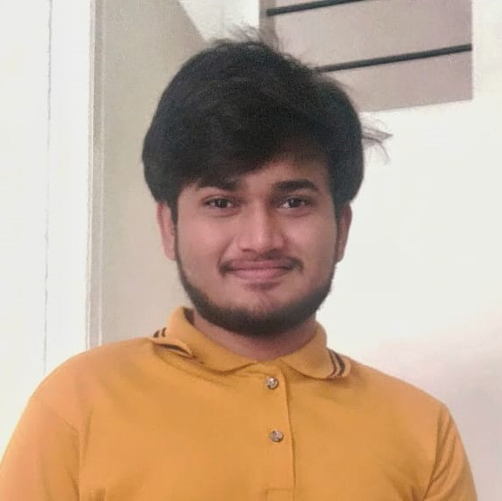
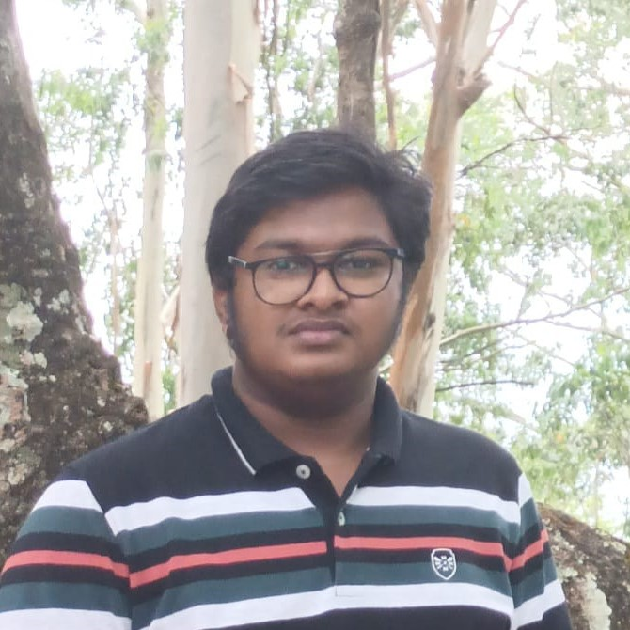
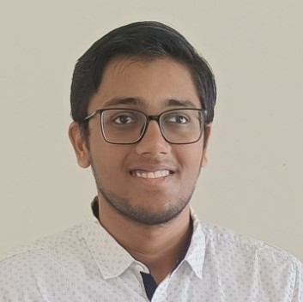
Core Team 2021
Shivani
Department of CSY
Jayant
Department of CSE
Richa
Department of CSY
Akhilesh
Department of CSY
Divyesh
Department of CSE
Arnav
Department of CSE

Slide 6
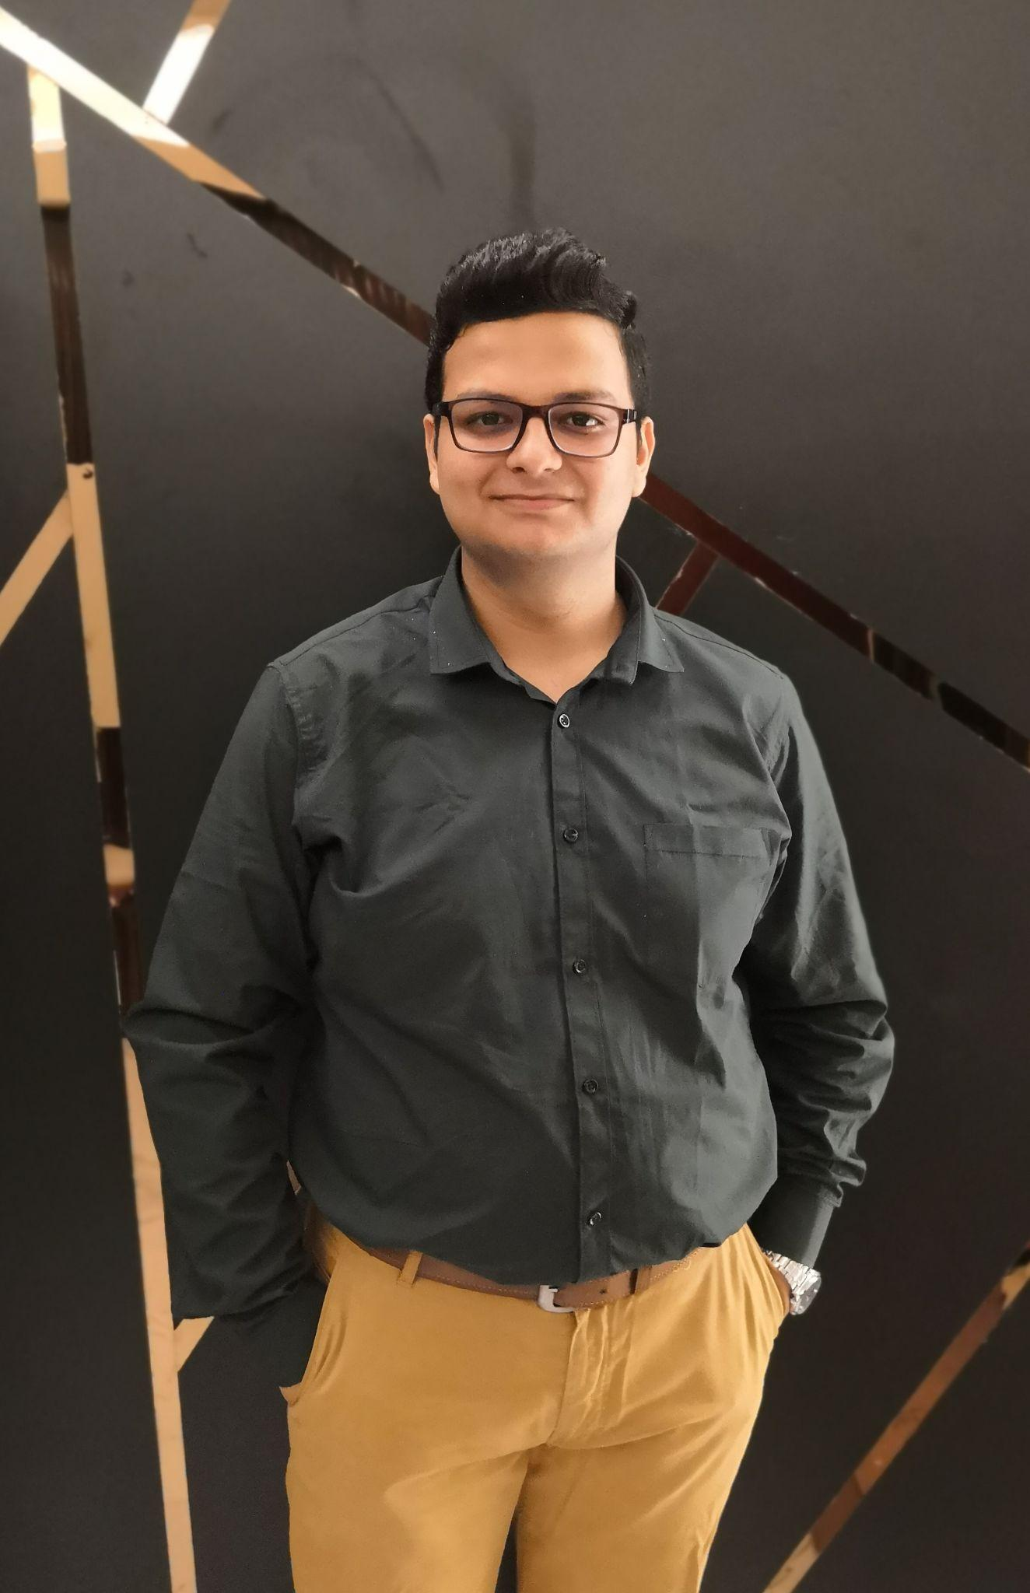
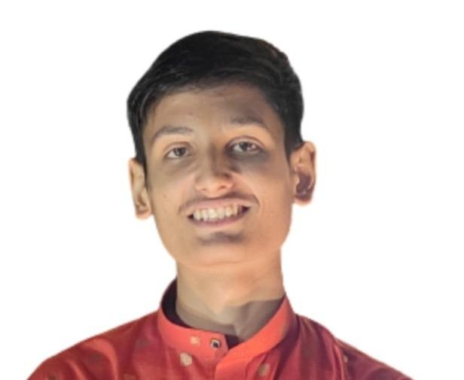
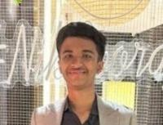
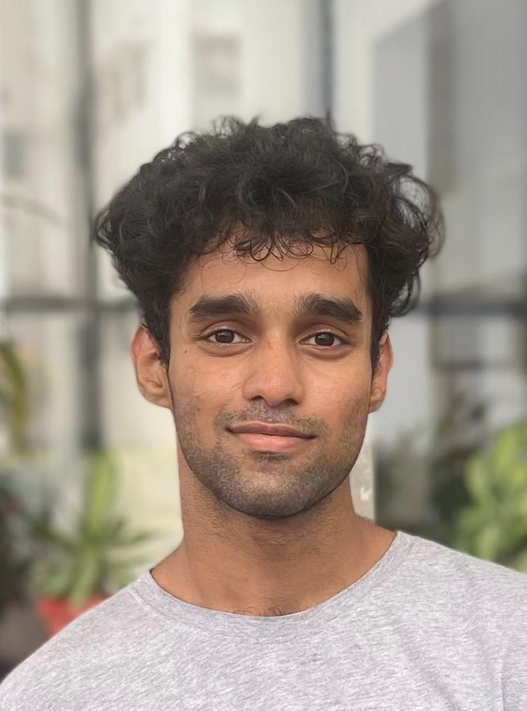
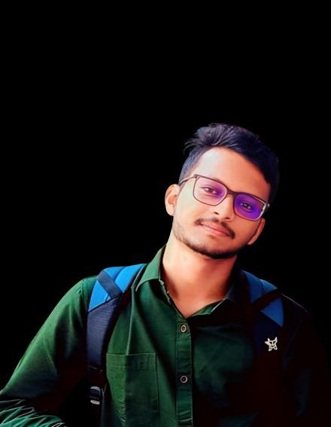
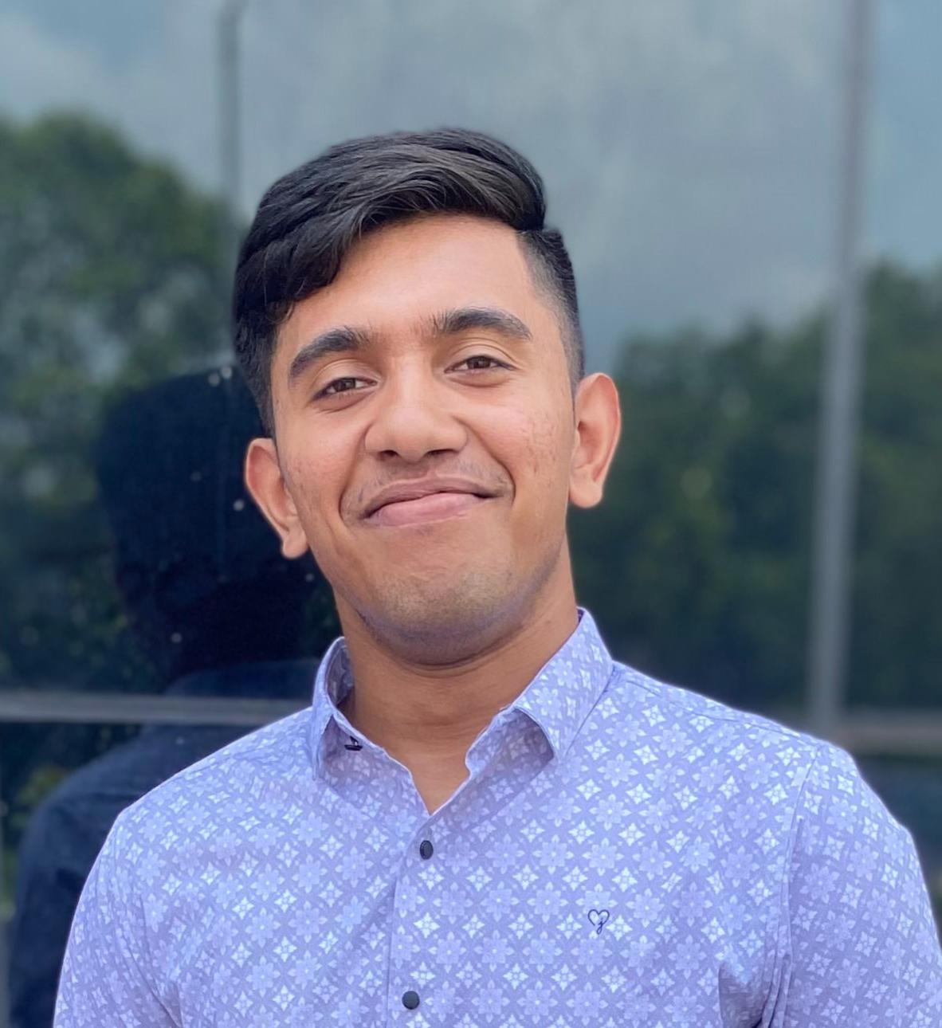
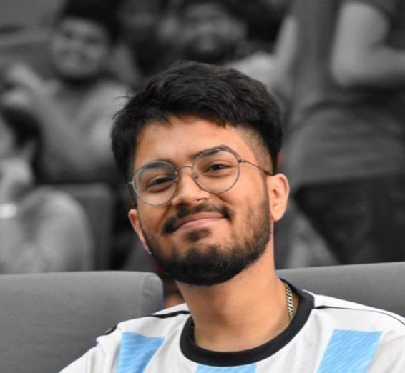
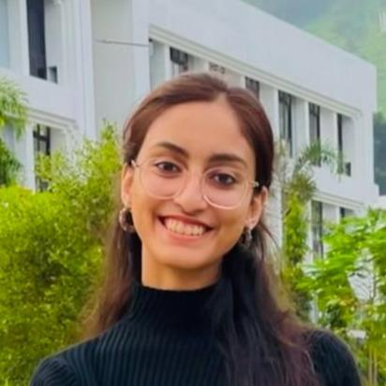
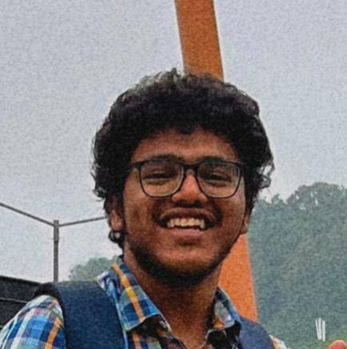
Core Team 2022
Sarthak
Department of CSY
Gunj
Department of CSE
Gaurav
Department of CSE
Purandhar
Department of CSE
Gowtham
Department of CSE
Abel
Department of CSE
Vedanta
Department of ECE
Shravasti
Department of CSY
Kaustubh
Department of CSE

Slide 7
Timeline & Events
Jan 13 Club Inauguration
EcoCrypt - Open Source Cipher Project
Introduction to Cyber Security
Capture the Flag - Apoorv CTF
Introduction to Web3.0 & Smart Contracts
Reimagining the Future of Drones
Advanced Cryptography Digital-Forensics

Slide 8
Future Projects
Achievements Dashboard - IIITK
A single place to showcase all the badges you earned in IIIT Kottayam from all the clubs, in all events.
Blockchain verified dashboard, displays your achievements.
Plan of Action:
1 month Blockchain Learning Phase
Development Phase of the Project

Slide 9
Elite Membership
Attend all the Cyber Security Club sessions
Active participation in projects,events…
Achieve in Cyber Security
-AAA Policy
Ajay Krishna

Slide 10
The Perks of Elite Membership
A Certificate at the end of the Academic year for active participation.
Badges for your Github and Linkedin profiles
Cyber Security Club Elite Merchandise

Slide 11


What is Cybersecurity
Protection of Data
Continuous monitoring
Risk management

Slide 12
Movie Time!
https://youtu.be/YOQUVpEGyqg?si=HA0pIMh0rfX66tyg&t=135

Slide 13
Puzzle:
Shopping Website
Try to break(cheat?) this website
Pay attention to the details!

Slide 14
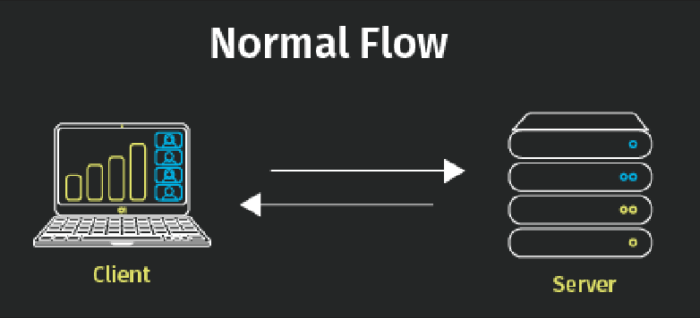
Payment Portals

Slide 15
Payment Portals
password123

Slide 16
Payment Portals
password123

Slide 17
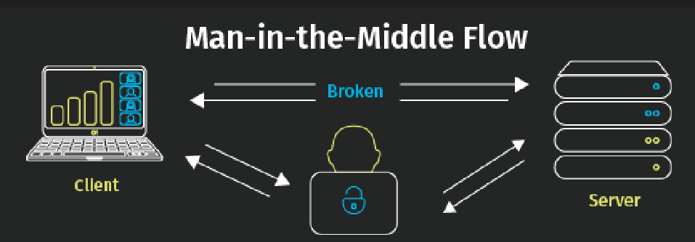
Payment Portals

Slide 18
Payment Portals
password123

Slide 19
Payment Portals
!!
password123

Slide 20
Payment Portals
password123

Slide 21
“Hiding” and “Unhiding” Messages
Magic spell - converts our message into a secret language that no one except itself can understand
Only we have the recipe for this secret “magic spell”
“Magic spell”
password123
as6abc7qLt
“Magic spell”
password123
as6abc7qLt

Slide 22
Secured Payment Portals
password123

Slide 23
Secured Payment Portals
as6abc7qLt

Slide 24
Secured Payment Portals
??
as6abc7qLt

Slide 25
Secured Payment Portals
as6abc7qLt

Slide 26
Secured Payment Portals
password123

Slide 27
Cryptography
F(x) = <mathematical expressions…>
= Result
Study of these “magic spells”
These magic spells are nothing but complex mathematical functions

Slide 28
Cryptography
F(“password123”) = “as6abc7qLt”
Study of these “magic spells”
These magic spells are nothing but complex mathematical functions

Slide 29
Cryptography
Study of these “magic spells”
These magic spells are nothing but complex mathematical functions
“Encryption”
password123
as6abc7qLt
“Decryption”
password123
as6abc7qLt

Slide 30
Yahoo data breach
Yahoo exposes three billion users' data
Why did it happen ?
massive user base - emails, passwords, personal info
outdated software
Weak Passwords
Unencrypted Data - sensitive info vulnerable to theft

Slide 31
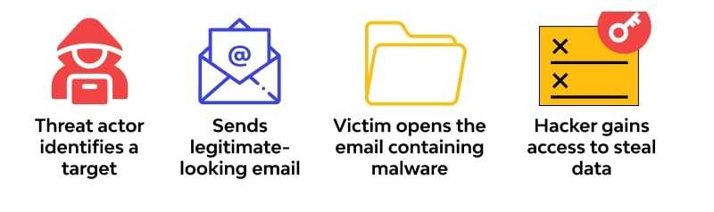
How did it happen ?
The initial access - spear phishing attacks.

Slide 32
Malicious web cookies-
"Cookies" are small pieces of data that websites store on a user's computer when they visit a site.
Helps in improving user experience
They contain info such as login credentials or session identifiers
If the website is not properly coded hackers can manipulate the cookies such that it allows access to any account without a password .

Slide 33
6,000,000,000,000
By 2022

Slide 34
Scope of Cybersecurity
Hackers attack every 39 seconds, on an average of 2,244 times a day
In the MIT technology review CyberDefense Index (CDI) 2022/23 has put India at No. 17 among 20 countries.
digital economies on their preparation against, and response and recovery from cybersecurity threats.
3.5 million cyber security jobs by 2025

Slide 35
Learning path
Linux
Networks
Ctfs
- Pico ctf
Try hack me
PreSecurity
Introduction to Cyber Security
Complete Beginner
Hack the box
Portswigger
Roadmap.sh

Slide 36

Thanks!
Scan this QR for all the important links!

